Slide 1
Optimization Approaches in Computer Vision and Image Processing
Gaurav Naukudkar-160001040
Biplab Kumar Sahoo-160001015

Slide 2
Introduction
The CVIP(Computer Vision and Image Processing) problems are conventionally solved by making spline or polynomial functions or determining parameters by least square method.
Waltz filtering is a method that provides relaxation. All these methods require simultaneous equation solving.
A neural network known as the Boltzmann machine based on principle of analogy to statistical mechanics was helpful in optimization of many problems.
All the optimization problems in CVIP are asolved by relaxation and regularization.

Slide 3
Relaxation
In the case of CVIP relaxation is used as a means of resolving a calculus of variations which deals with the extremal problem of function that represent a certain index that needs to be extremize in the entire image.
Such a problem can be resolved using the Euler’s equation.

Slide 4
When Euler’s equation is used it becomes a problem of solving simultaneous equations obtained by discretizing this partial differential equation per pixel.
Since the coefficient matrix of such simultaneous equations becomes large and non-dense relaxation is used as a method for numerically solving the problems of CVIP.

Slide 5
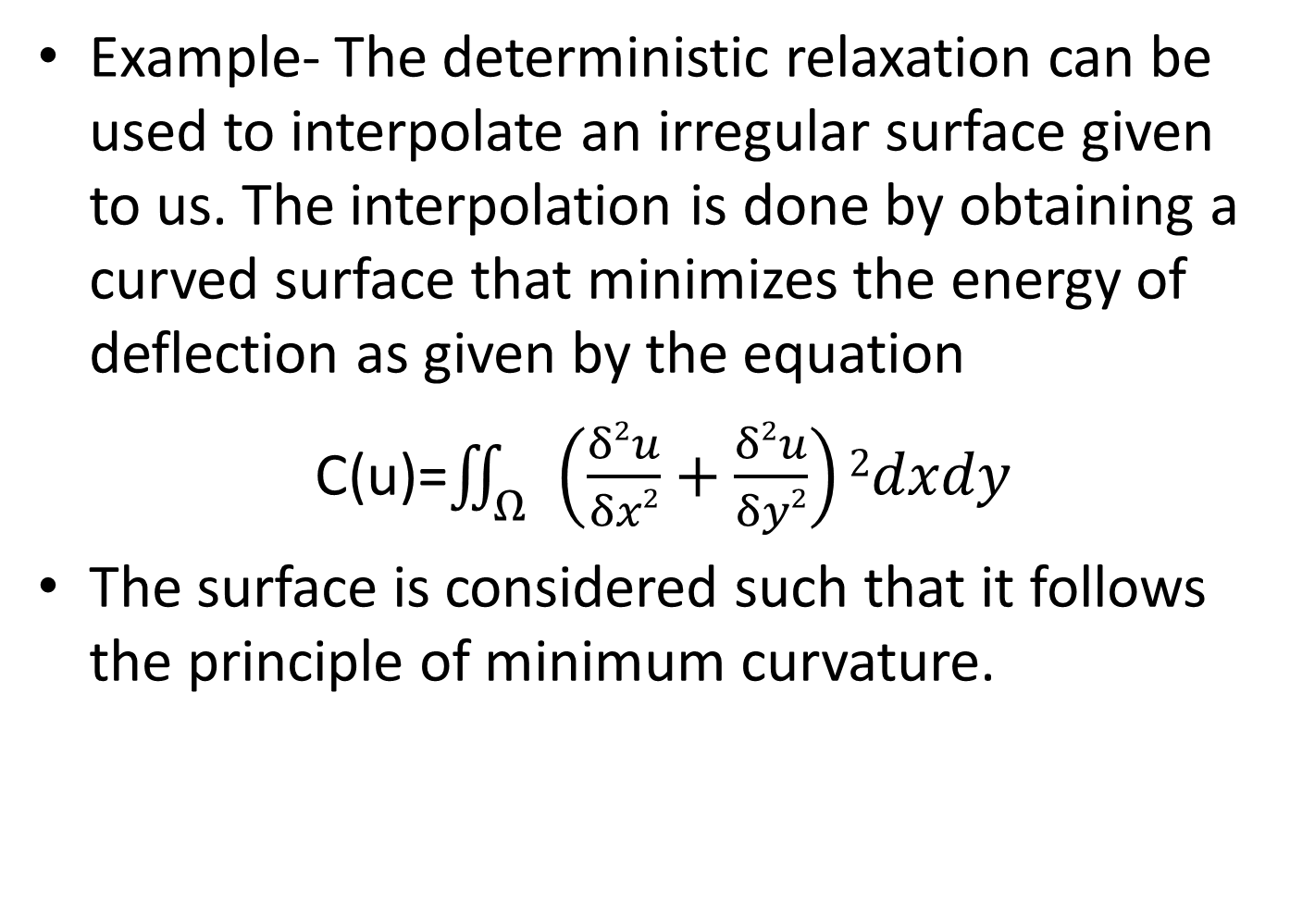
Example- The deterministic relaxation can be used to interpolate an irregular surface given to us. The interpolation is done by obtaining a curved surface that minimizes the energy of deflection as given by the equation
C(u)=$\iint_{Ω}{\left(\frac{δ2u}{δx2}+\frac{δ2u}{δy2}\right)2dxdy}$
The surface is considered such that it follows the principle of minimum curvature.

Slide 6
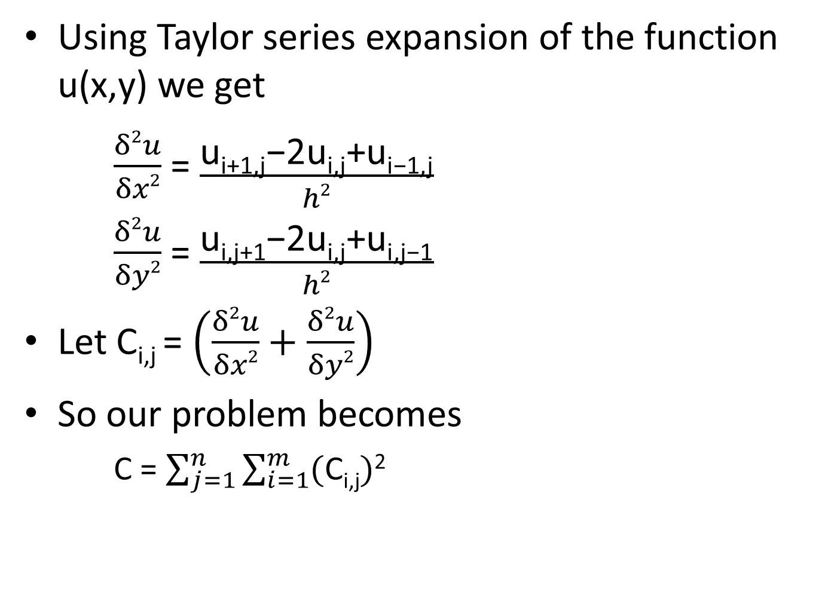
Using Taylor series expansion of the function u(x,y) we get
$\frac{δ2u}{δx2}$ = $\frac{\text{u}\text{i}\text{+1,}\text{j}\text{−}\text{2}\text{u}\text{i}\text{,}\text{j}\text{+}\text{ui}\text{−}\text{1,}\text{j}}{h2}$
$\frac{δ2u}{δy2}$ = $\frac{\text{u}\text{i}\text{,}\text{j}\text{+1}\text{−2}\text{ui}\text{,}\text{j}\text{+}\text{ui}\text{,}\text{j}\text{−1}}{h2}$
Let C_{i,j} = $\left(\frac{δ2u}{δx2}+\frac{δ2u}{δy2}\right)$
So our problem becomes
C = $\sum_{j=1}^{n}{\sum_{i=1}^{m}{(\text{C}\text{i}\text{,}\text{j})}}$²

Slide 7
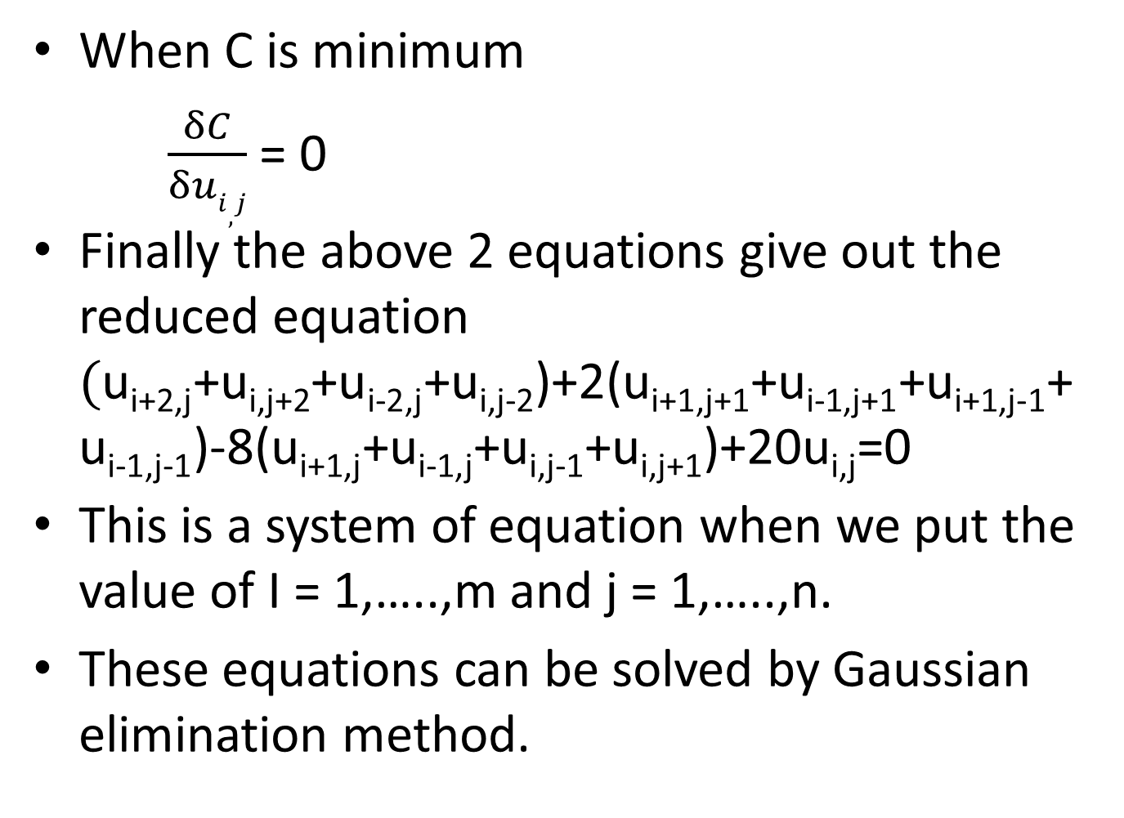
When C is minimum
$\frac{δC}{δui,j}$ = 0
Finally the above 2 equations give out the reduced equation $(\text{u}\text{i}\text{+2,}\text{j}$+$\text{u}\text{i}\text{,}\text{j}\text{+2}\text{+}\text{u}\text{i}\text{−2}\text{,}\text{j}$+$\text{u}\text{i}\text{,}\text{j}\text{−2}$)+2($\text{u}\text{i}\text{+1,}\text{j}\text{+1}$+$\text{u}\text{i}\text{−}\text{1,}\text{j}\text{+1}$+$\text{u}\text{i}\text{+1,}\text{j}\text{−1}$+$\text{u}\text{i}\text{−}\text{1,}\text{j}\text{−1}$)-8($\text{u}\text{i}\text{+1,}\text{j}$+$\text{u}\text{i}\text{−}\text{1,}\text{j}$+$\text{u}\text{i}\text{,}\text{j}\text{−1}$+$\text{u}\text{i}\text{,}\text{j}\text{+1}$)+20$\text{u}\text{i}\text{,}\text{j}$=0
This is a system of equation when we put the value of I = 1,…..,m and j = 1,…..,n.
These equations can be solved by Gaussian elimination method.

Slide 8
Regularization
Not every problem of CVIP can be solved by relaxation. For example some 3-D images when are saved and observed in 2-D they have degenerated shapes. Such problems are called ill-posed problems.
For ill-posed problems we need a method known as regularization.
Regularization method gives none or more than one solutions.

Slide 9
The basic method of doing regularisation is pretty much same as that of relaxation.
We interpolate a surface and for that, from an equation of surface given to us, we find out multiple equations to be solved.
To make regularization more useful it was later made as it can use 2 constraints.
When f₁(x) and f₂(x) are constraint functions, the constraint condition can be expressed as follows:
(y − f₁(x))(y − f₂(x))
= y² − (f₁(x)+ f₂(x))y + f₁(x)f₂(x)=0

Slide 10
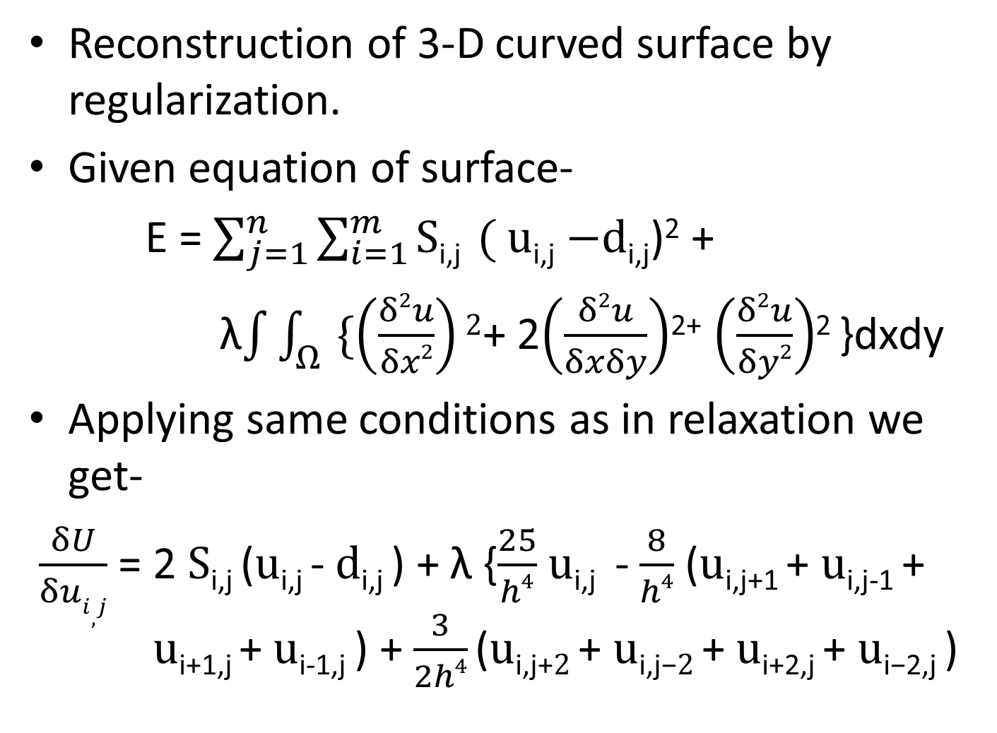
Reconstruction of 3-D curved surface by regularization.
Given equation of surface-
E = $\sum_{j=1}^{n}{\sum_{i=1}^{m}{\text{S}\text{i}\text{,}\text{j} }(}$ $\text{u}\text{i}\text{,}\text{j}$ $−\text{d}\text{i}\text{,}\text{j}$)² +
λ$\int{\int_{Ω}{\{\left(\frac{δ2u}{δx2}\right)2}}$+ 2$\left(\frac{δ2u}{δxδy}\right)$²⁺ $\left(\frac{δ2u}{δy2}\right)$² }dxdy
Applying same conditions as in relaxation we get-
$\frac{δU}{δui,j}$ = 2 $\text{S}\text{i}\text{,}\text{j}$($\text{u}\text{i}\text{,}\text{j}$- $\text{d}\text{i}\text{,}\text{j}$) + λ {$\frac{25}{h4}$ $\text{u}\text{i}\text{,}\text{j}$ - $\frac{8}{h4}$ ($\text{u}\text{i}\text{,}\text{j}\text{+1}$+ $\text{u}\text{i}\text{,}\text{j}\text{−1}$+ $\text{u}\text{i}\text{+1}\text{,}\text{j}$+ $\text{u}\text{i}\text{−1}\text{,}\text{j}$) + $\frac{3}{2h4}$($\text{u}\text{i}\text{,}\text{j}\text{+}2$+ $\text{u}\text{i}\text{,}\text{j}\text{−}2$+ $\text{u}\text{i}\text{+2,}\text{j}$+ $\text{u}\text{i}\text{−2,}\text{j}$)

Slide 11
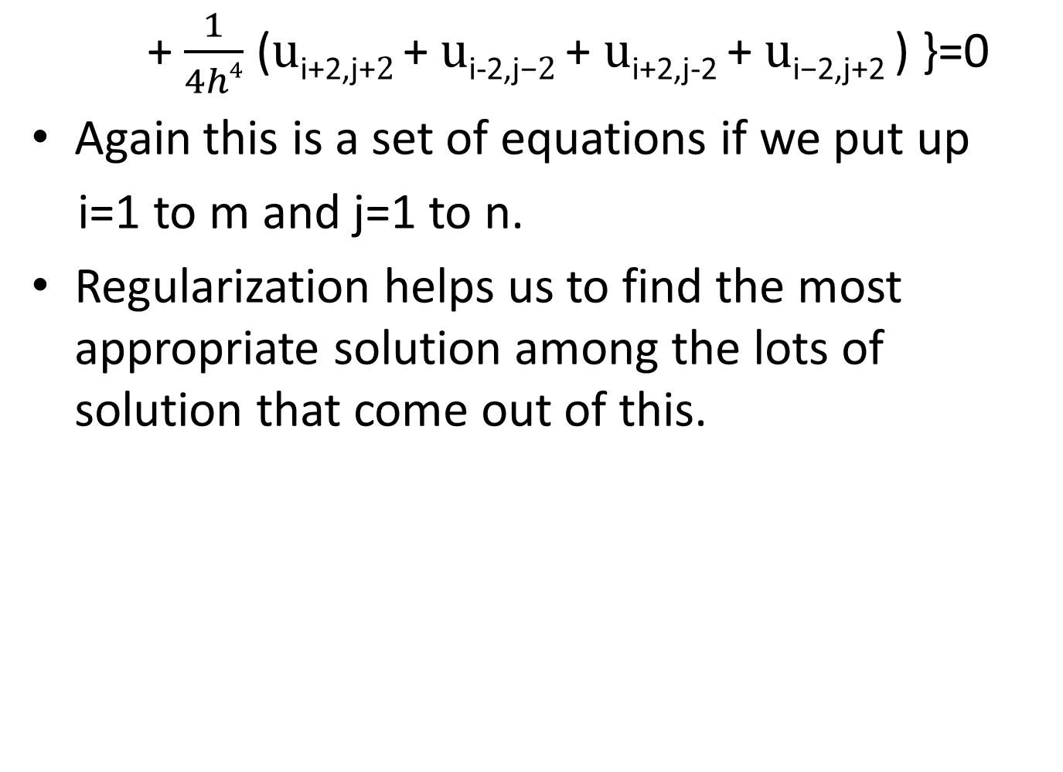
+ $\frac{1}{4h4}$ ($\text{u}\text{i}\text{+2}\text{,}\text{j}\text{+}2$+ $\text{u}\text{i}\text{−2}\text{,}\text{j}\text{−}2$+ $\text{u}\text{i}\text{+2,}\text{j}\text{−2}$+ $\text{u}\text{i}\text{−2,}\text{j}\text{+2}$) }=0
Again this is a set of equations if we put up
i=1 to m and j=1 to n.
Regularization helps us to find the most appropriate solution among the lots of solution that come out of this.

Slide 12
Genetic Algorithm
An optimum solution problem like generation of the image-processing genetic sequence can be solved using Genetic algorithms.
In these algorithms first of all the target object is searched in the image by given parameter search. The search can be of various types depending upon situation i.e. line search, areal search or so.
Shape model fitting is a the following methodology in which we by observing the shape of the target object from the interpolated image judge its properties.

Slide 13
For example, in an extracted line from the image pixels have chromosomes that tell us the direction and coordinates of edges. Pixels that inherit the trait of the parents are generated at the dividing points of parent chromosome pixels. This shows the crossover of chromosomes as the neighbouring pixels. The optimization can be applied on these kind of problems because the crossing over is actually taking place in a 3-D region while we can observe these phenomena in a 2-D vision only.

Slide 14
Image reconstruction is the main purpose of the optimization in image processing. This has been tried in genetic problems too. Like the method of regularization can be applied in genetic problems too.
GAs always provide a forward solution rather than an inverse one. This is the most advantageous point in using GA for image reconstruction.

Slide 15
References-
-D. Lee and T. Pavlidis, “One-dimensional regularization with discontinuities,” Trans. PAMI, vol.10, no.6, pp.822– 829, 1988
-S. Kirkpatrick, C.D. Gelatt, Jr., and M.P. Vecchi,
“Optimization by simulated annealing,” Science, vol.220, no.4598, pp.671–680, 1983
-S. Kichenassamy, A. Kumar, P. Olver, A. Tannenbaum, and A. Yezzi, “Gradient ﬂows and geometric active contour Models,” 5th ICCV, pp.810–815, 1995
-T.E. Boult and M. Lerner, “Energy-based segmentation of very sparse range surfaces,” IUW, pp.565–572, 1990

